Slide 1


GreenEvents: Eco Web Platform

Slide 2


01
Kick-off & Team

Slide 3

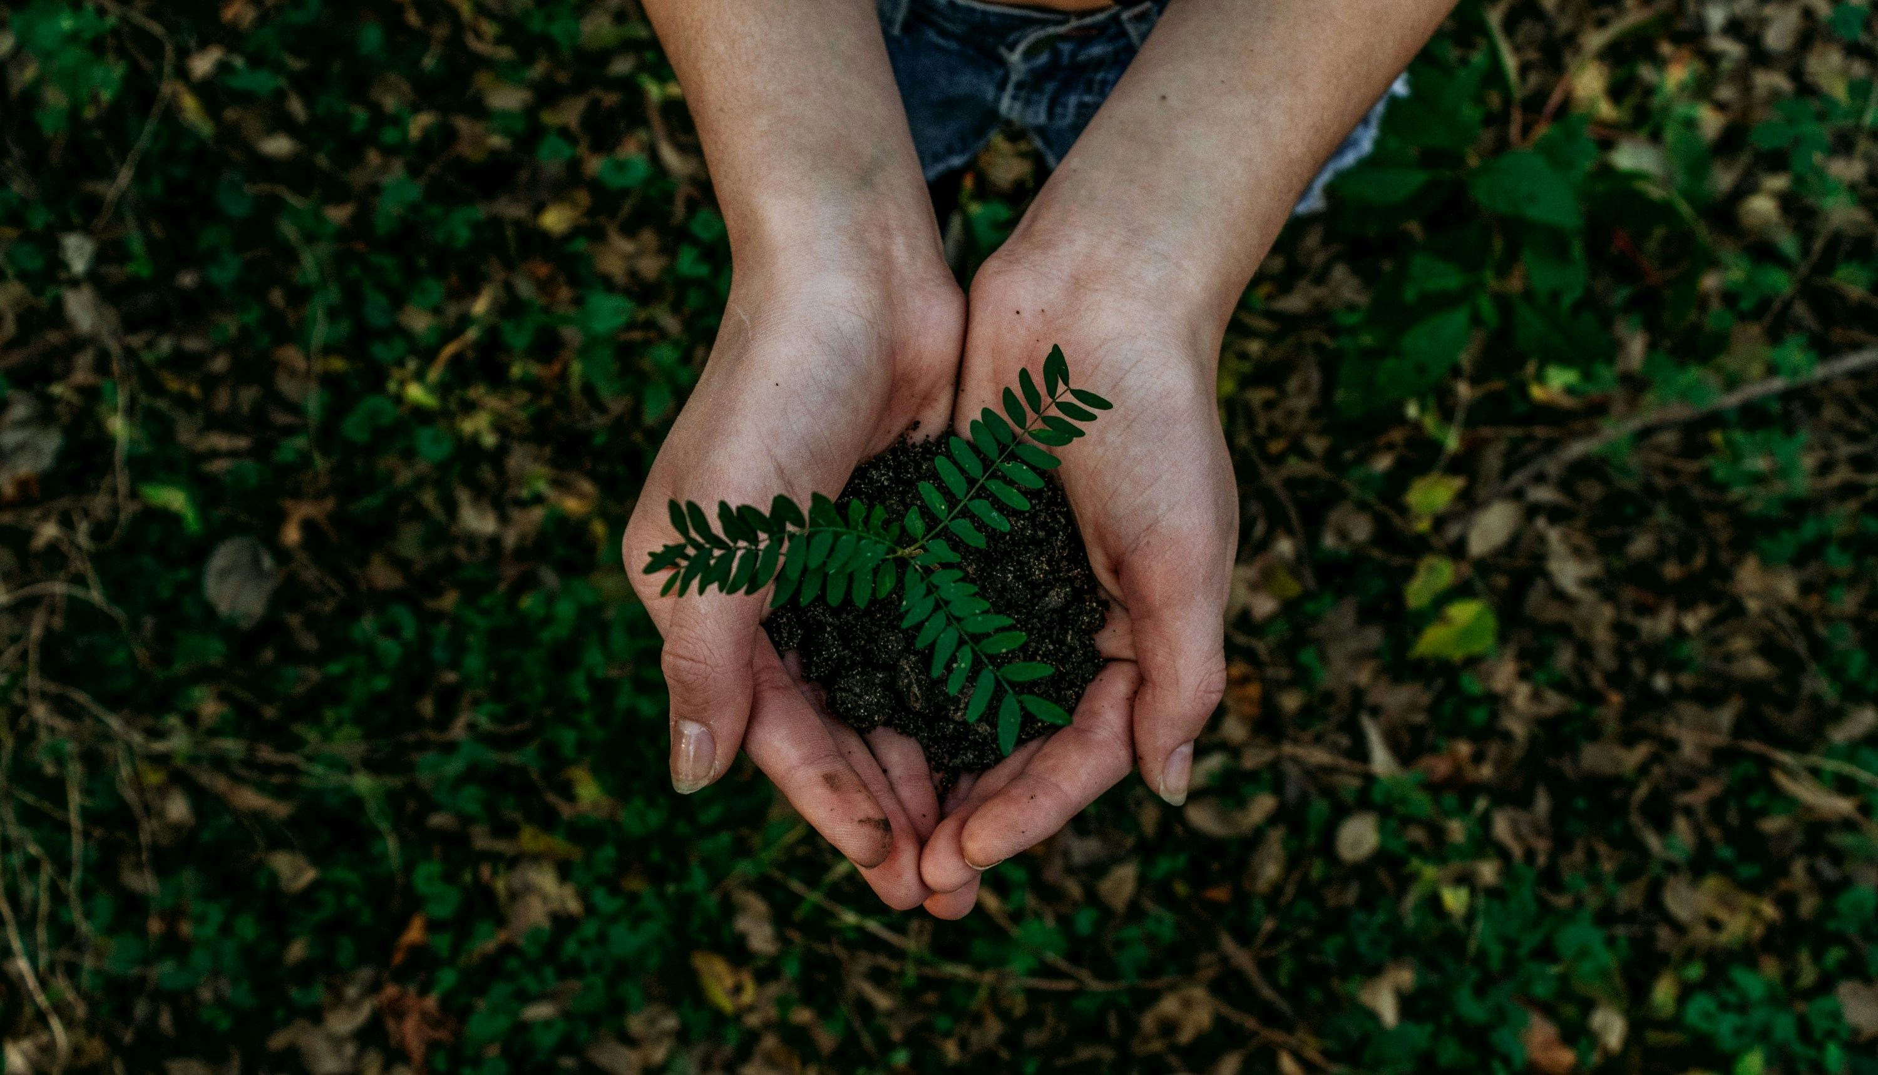
GreenEvents
Environmental Event Management Platform
COMP-8347 Web Application Development Project
Group 9: Zin, Neela, Niket, Munna, Shaurya
Fall 2025
GitHub: https://github.com/IShauryaI/Event-Organiser

Slide 4
Meet the Team: Balanced Contributions
Zin
Neela
Niket
Munna
Shaurya
Event Management
Registration System
Search & Filtering
Sessions & Tracking
UI/UX & Uploads
20%
20%
20%
20%
20%

Slide 5
02
Problem & Solution

Slide 6
The Challenge: A Fragmented Landscape
Fragmented Information
Low Engagement
No Impact Tracking
Poor Organizer Tools
Environmental events are scattered across various platforms.
Volunteers struggle to find and commit to events.
A lack of centralized data on collective environmental impact.
Event organizers lack efficient management solutions.

Slide 7
Centralized Event Discovery
Streamlined Registration
Introducing GreenEvents
A comprehensive solution designed to address the key pain points in environmental event management.
Real-time Analytics
Gamification (Badges)
Pro Organizer Dashboard
Email Notifications

Slide 8
03
Core Features

Slide 9
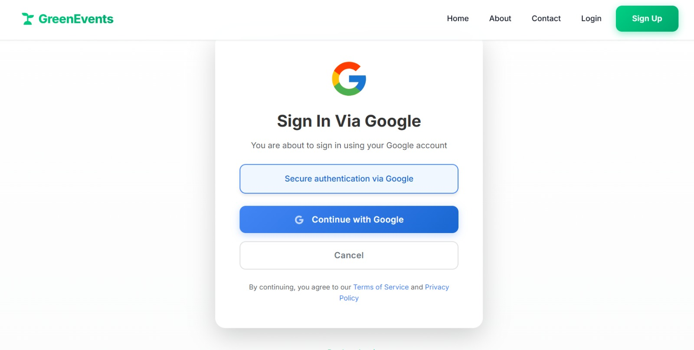
Authentication
Dual signup for Volunteers & Organizers
Integrated Google OAuth for seamless access
Event Management
Full CRUD functionality for events
Categorization (e.g., Tree Planting, Beach Cleanup)
Support for cover image uploads

Slide 10
Key Features: Seamless Interaction
Registration System
Search & Filter
One-click registration
Full-text search functionality
Real-time capacity management
Category-based filtering
Automated email confirmations
Pagination (20 events/page)

Slide 11
04
Architecture & Data

Slide 12
Our Modern Technology Stack
Backend
Frontend
Tools
Python 3.13 + Django 5.2.7
HTML5, CSS3, JavaScript
Git/GitHub
SQLite Database
Bootstrap 5.3
PythonAnywhere (Hosting)
Django Allauth (Google OAuth)
Gmail SMTP

Slide 13
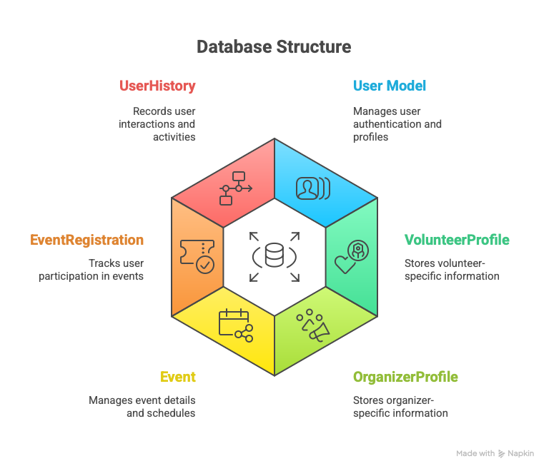
Database Architecture
Our data model is built around six core entities, ensuring a normalized and scalable structure.
User
VolunteerProfile
OrganizerProfile
Event
EventRegistration
UserHistory

Slide 14
05
Value Adds & Hurdles

Slide 15
Bonus Features !
Going beyond the basics to deliver a richer user experience.
Analytics Dashboards
Gamification (Badges)
User Activity Tracking
Environmental Impact Metrics
Professional UI/UX
JSON Fixtures for Demo Data

Slide 16
Overcoming Development Obstacles
Challenge 1: Image Uploads
Solution: Added request.FILES & enctype="multipart/form-data"
Challenge 2: Pagination & Search
Solution: Preserved GET parameters in pagination URLs.
Challenge 3: Dashboard Size (2500px!)
Solution: Optimized to 600px, a 76% reduction.
Challenge 4: Gmail Auth Failed
Solution: Implemented Gmail App Password for secure sending.

Slide 17
06
Quality & Metrics

Slide 18
100% Test Success Rate
Feature | Test Cases | Passed | Failed
Authentication | 5 | 5 | 0
Event CRUD | 8 | 8 | 0
Registration | 6 | 6 | 0
Search & Filter | 4 | 4 | 0
TOTAL | 23 | 23 | 0
Rigorous testing ensures platform reliability and a bug-free user experience.
Cross-Platform & Responsive
• Chrome, Firefox, Edge, Safari
• Desktop, Laptop, Tablet, Mobile

Slide 19
Project Statistics: By The Numbers
11 Weeks
3,000+
5 Members
Development Time
Lines of Code
Team Size
20+
38
6 Models
Features
Test Cases
Database Models
30+
130 Users
60 Events
Templates
(100 Volunteers, 30 Orgs)
Created in System

Slide 20
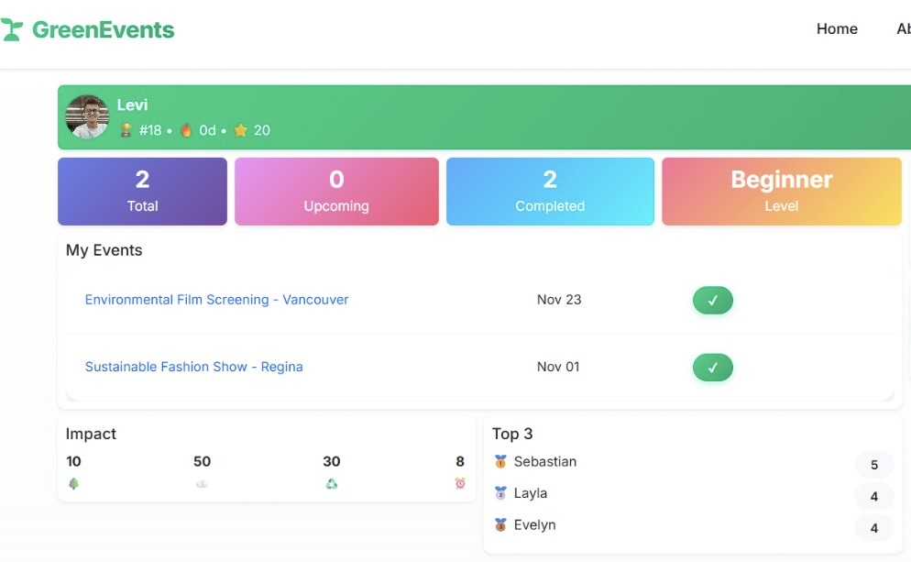
Making a Difference
Our platform is designed to empower and track real environmental change.
Track trees planted and CO2 saved.
Monitor waste collected and volunteer hours.
130
300+
Active Users
Registrations

Slide 21
07
Roadmap & Closure

Slide 22
Future Enhancements: Our Roadmap
1
2
3
4
Social Features
Mobile App
AI Integration
Enhanced Gamification
Messaging, Reviews, Sharing
React Native, QR Check-in
Smart Recommendations
Challenges, Leaderboards

Slide 23
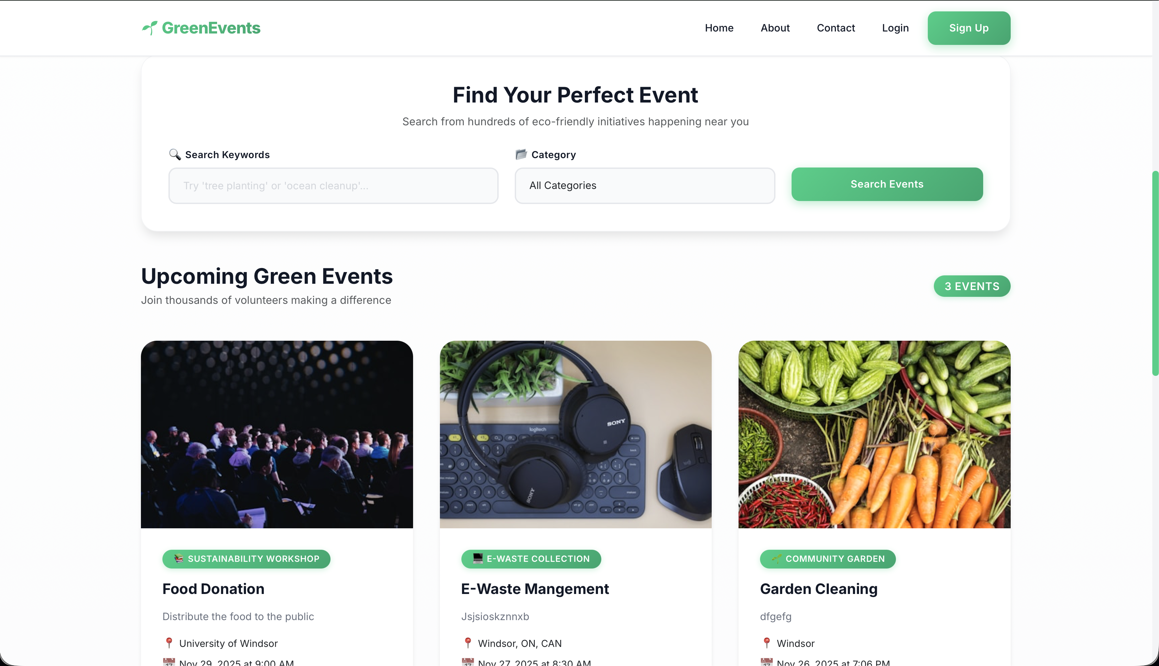
Live Demonstration
A quick tour of the platform's core user journeys:
1. Homepage with event discovery
2. Search and filter in action
3. Seamless volunteer registration
4. Personalized volunteer dashboard
5. Organizer event creation
6. Powerful analytics overview

Slide 24
Key Takeaways & Learnings
What We Built
What We Learned
A fully functional environmental event platform.
20+ features with a 100% test success rate .
A professional, responsive, and accessible design.
A solution with real-world impact potential.
Full-stack development with Django.
Effective team collaboration using Git.
Database design and optimization techniques.
Deployment, hosting, and CI/CD practices.

Slide 25
Get In Touch
GitHub: https://github.com/IShauryaI/GreenEvents
Live Site: https://greenevents.pythonanywhere.com
Team Members
Zin Mar Htwe
Neela Priya Das
Niket Bhavesh Bhatt
Munna Chowhan
Shaurya Parshad
Thank You! Questions?

Slide 26

THANK YOU
2025/08/05

